Slide 1

DESIGN
‘PATTERN’
IN JAVA
[GoF Design Patterns]

Slide 2
[Structural Patterns]

Slide 3
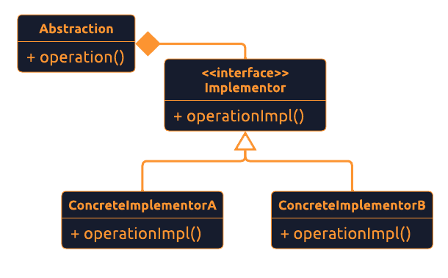
[ What is ‘Bridge’? ]
[ Object Structural ]
Why?
<Defines an abstract object structure independently of the implementation object structure in order to limit coupling./>
When?
<It used :
Abstraction and implementation should not be bound at compile time & they should be independently extensible.
Changes in implementation of an abstraction should have no impact on clients.
Implementation details should be hidden from client./>
Example
<JVM has it’s own native functions which abstract the use of windowing, system logging, and byte code execution. But the actual implementation of these functions is delegated to OS the JVM is running on. So, each time it calls the concrete implementation of the JVM that knows how to communicate with OS./>

Slide 4
‘Bridge’
[Implementation & Testing]
<We are going to:
Create interfaces Animal & Color />

